Slide 1
Digital Portfolio
STUDENT NAME: U.Priyadharshini
REGISTER NO AND NMID: 30324U18079 /ADBCD6AB18F2A7B9C97497ED797FF8E0
DEPARTMENT: Bsc.computer science
COLLEGE: Arcot sri mahalakshmi women's college/ Thiruvalluvar University

Slide 2
PROJECT TITLE
Portfolio using HTML, CSS, and JavaScript”

Slide 3


AGENDA
Problem Statement
Project Overview
End Users
Tools and Technologies
Portfolio design and Layout
Features and Functionality
Results and Screenshots
Conclusion
Github Link
3/21/2024 Annual Review

Slide 4

PROBLEM STATEMENT
Many students and professionals need a platform to showcase their skills, projects, and achievements effectively. Creating a digital portfolio using HTML, CSS, and JavaScript provides a structured, interactive, and visually appealing way to present personal and professional information online, making it accessible and engaging across devices.

Slide 5

PROJECT OVERVIEW
Personal Portfolio Website This project is a digital portfolio created using HTML, CSS, and JavaScript. It showcases personal details, education, skills, hobbies, and projects in a visually appealing and interactive way. Features include smooth navigation, responsive design, and dynamic elements like form validation and hover effects. The portfolio enhances personal branding and provides a professional online presence.

Slide 6

WHO ARE THE END USERS?
The end users of a portfolio created with HTML, CSS, and JavaScript include employers and recruiters who want to evaluate your skills and projects, clients looking to assess your work for potential projects, peers or colleagues seeking inspiration or collaboration, and general visitors interested in learning about your work and achievements.

Slide 7

TOOLS AND TECHNIQUES
Tools: Code Editors: VS Code, Sublime Text, Brackets Browsers & Dev Tools: Chrome, Firefox, Edge
Techniques: HTML: Use semantic tags, lists, forms, and media elements. CSS: Flexbox/Grid for layout, animations, transitions, responsive design. JavaScript: Interactive elements, form validation, sliders, dynamic content.

Slide 8
POTFOLIO DESIGN AND LAYOUT
The portfolio provides a clean and professional digital presence using HTML, CSS, and JavaScript. It includes sections like About, Skills, Projects, and Contact, with interactive elements and animations for an engaging user experience. The design effectively showcases personal information, technical skills, and completed projects in a polished, user-friendly layout.
8

Slide 9
FEATURES AND FUNCTIONALITY
A portfolio using HTML, CSS, and JavaScript is interactive and visually appealing. It includes sections like Home, About, Skills, Projects, and Contact, with smooth navigation and responsive design. Skills and projects can be showcased with animations, progress bars, or interactive cards. JavaScript adds dynamic effects like modals, tooltips, and form validation, making the portfolio engaging and professional.

Slide 10
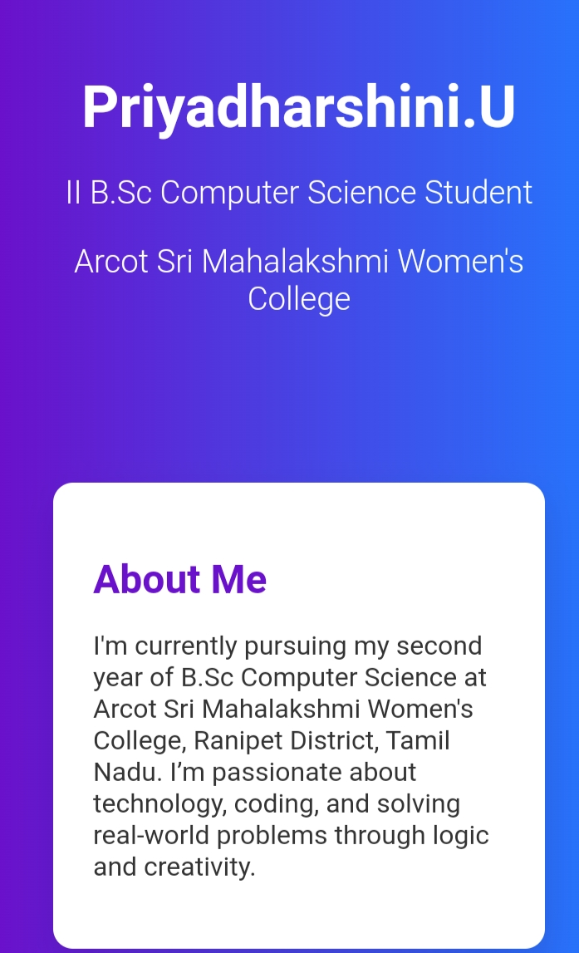

RESULTS AND SCREENSHOTS
3/21/2024 Annual Review
10

Slide 11
CONCLUSION
This portfolio demonstrates a comprehensive application of HTML, CSS, and JavaScript to create a visually appealing and interactive digital presence. HTML structures the content effectively, CSS enhances the design with colors, layouts, and responsiveness, while JavaScript adds dynamic features and interactivity. The project showcases personal skills, projects, and achievements in a professional manner. Overall, it serves as an effective tool for self-presentation and highlights the practical integration of front-end web technologies.
11

